Slide 1
Mehran S. Fallah May 2020
Programming Languages
Session VII
The Lambda-Calculus

Slide 2

Introduction
The untyped (pure) lambda-calculus was introduced in our previous session.
It was shown how one can write a program in the calculus using its tiny syntax.
In particular, Booleans, numbers, conditionals, pairs, and some functions, such as addition, multiplication, and subtraction, were simulated in the lambda-calculus.
To show that the proposed calculus is Turing complete, however, one must show that all computable functions can be encoded in the pure lambda-calculus.
In fact, it must be shown that (general) recursion can be introduced into the lambda-calculus.
In this session, we first explain how one can encode a recursive function definition as a fixed point of a functional—a functional is defined to be a function from the set of functions to itself.
Then, we give so-called fixed-point combinators for the evaluation strategies call-by-name and call-by-value so that one can specify the computation of the fixed point of a given function.
t ::= x | $λ$x. t | t t

Slide 3


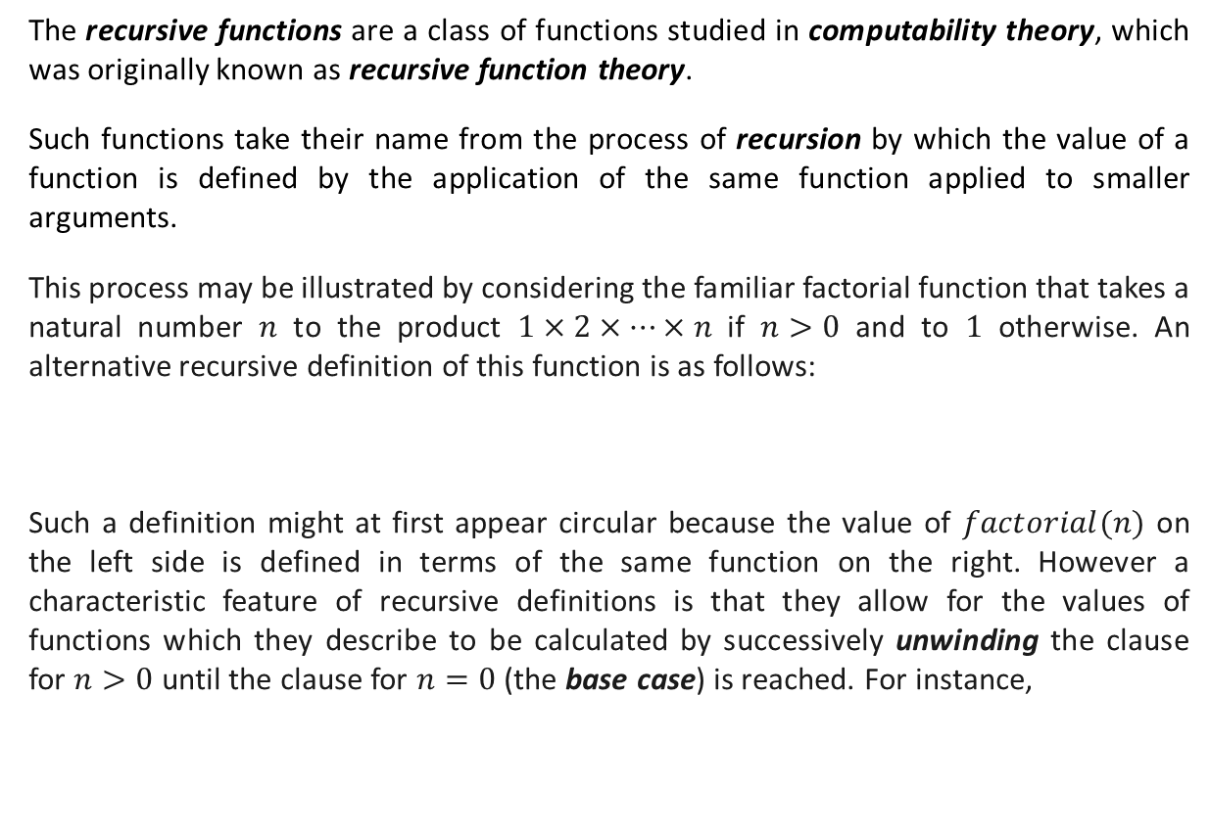



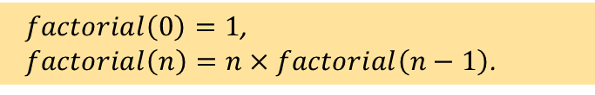

Recursive Function Definition
The recursive functions are a class of functions studied in computability theory, which was originally known as recursive function theory.
Such functions take their name from the process of recursion by which the value of a function is defined by the application of the same function applied to smaller arguments.
This process may be illustrated by considering the familiar factorial function that takes a natural number $n$ to the product $1×2×⋯×n$ if $n>0$ and to $1$ otherwise. An alternative recursive definition of this function is as follows:
Such a definition might at first appear circular because the value of $factorial(n)$ on the left side is defined in terms of the same function on the right. However a characteristic feature of recursive definitions is that they allow for the values of functions which they describe to be calculated by successively unwinding the clause for $n>0$ until the clause for $n=0$ (the base case) is reached. For instance,
$factorial\left(0\right)=1$,
$factorial\left(n\right)=n×factorial\left(n−1\right)$.
$$factorial\left(3\right)$$
$$=3×factorial\left(2\right)$$
$$=3×\left(2×factorial\left(1\right)\right)$$
$$=3×\left(2×\left(1×factorial\left(0\right)\right)\right)$$
$$=3×\left(2×\left(1×1\right)\right)$$
$$=6$$

Slide 4
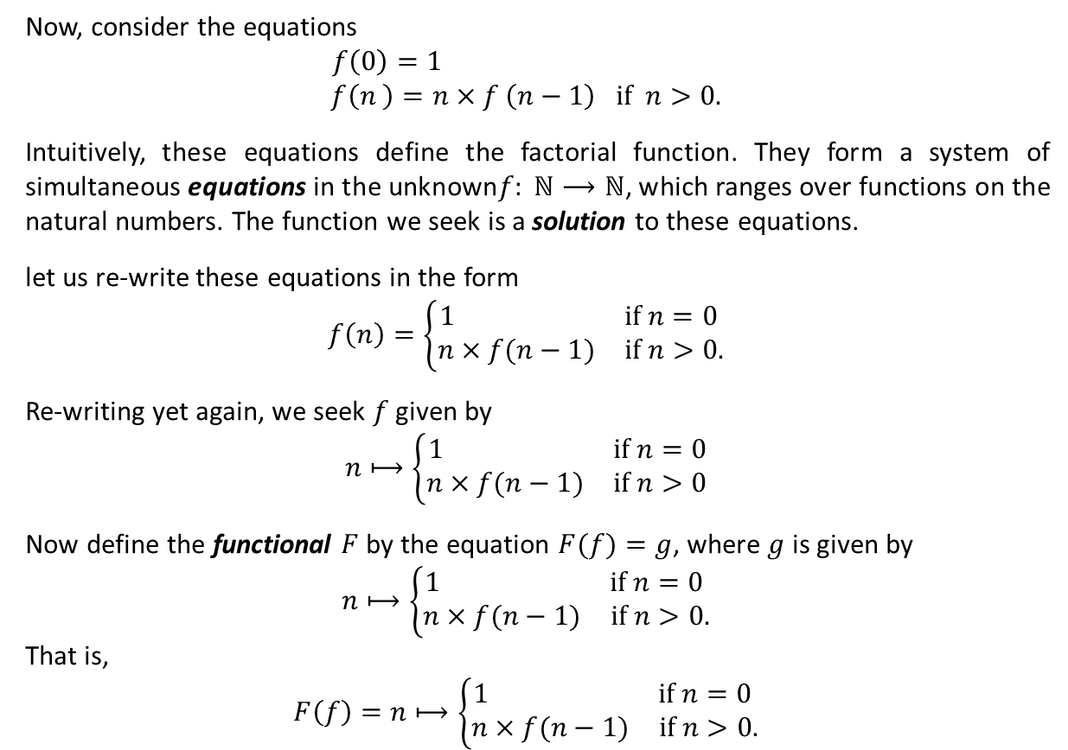
Recursive Function Definition (Ctd.)
Now, consider the equations
$$f\left(0\right)=1$$
$$f\left(n \right)=n×f \left(n−1\right) if n>0.$$
Intuitively, these equations define the factorial function. They form a system of simultaneous equations in the unknown$f: ℕ⟶ℕ$, which ranges over functions on the natural numbers. The function we seek is a solution to these equations.
let us re-write these equations in the form
$$f\left(n\right)=\left\{\begin{matrix}1 & if n=0 \\ n×f(n−1) & if n>0.\end{matrix}\right.$$
Re-writing yet again, we seek $f$ given by
$$n⟼\left\{\begin{matrix}1 & if n=0 \\ n×f(n−1) & if n>0\end{matrix}\right.$$
Now define the functional $F$ by the equation $F(f)=g$, where $g$ is given by
$$n⟼\left\{\begin{matrix}1 & if n=0 \\ n×f(n−1) & if n>0.\end{matrix}\right.$$
That is,
$$F\left(f\right)=n⟼\left\{\begin{matrix}1 & if n=0 \\ n×f(n−1) & if n>0.\end{matrix}\right.$$

Slide 5
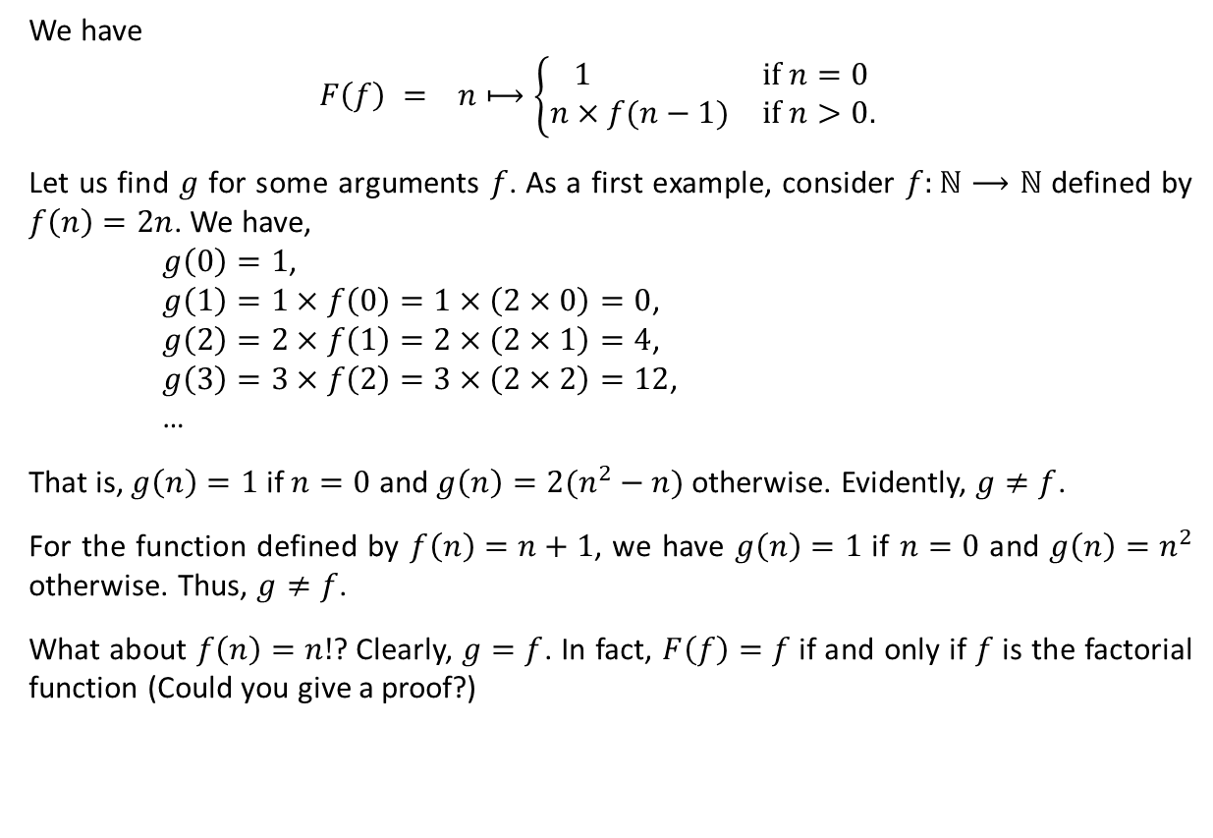

Recursive Function Definition (Ctd.)
We have
$$F\left(f\right) = n⟼\left\{\begin{matrix}1 & if n=0 \\ n×f(n−1) & if n>0.\end{matrix}\right.$$
Let us find $g$ for some arguments $f$. As a first example, consider $f:ℕ⟶ℕ$ defined by $f\left(n\right)=2n$. We have,
$g\left(0\right)=1$,
$g\left(1\right)=1×f\left(0\right)=1×\left(2×0\right)=0$,
$g\left(2\right)=2×f\left(1\right)=2×\left(2×1\right)=4$,
$g\left(3\right)=3×f\left(2\right)=3×\left(2×2\right)=12$,
…
That is, $g\left(n\right)=1$ if $n=0$ and $g\left(n\right)=2(n^{2}−n)$ otherwise. Evidently, $g≠f$.
For the function defined by $f\left(n\right)=n+1$, we have $g\left(n\right)=1$ if $n=0$ and $g\left(n\right)=n^{2}$ otherwise. Thus, $g≠f$.
What about $f\left(n\right)=n!$? Clearly, $g=f$. In fact, $F\left(f\right)=f$ if and only if $f$ is the factorial function (Could you give a proof?)
$$g$$
A fixed point of a function $f:A⟶A$ is an element $a∈A$ such that $f\left(a\right)=a$.
The factorial function is the fixed point of the functional $F$ defined above.

Slide 6
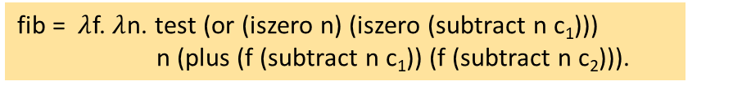
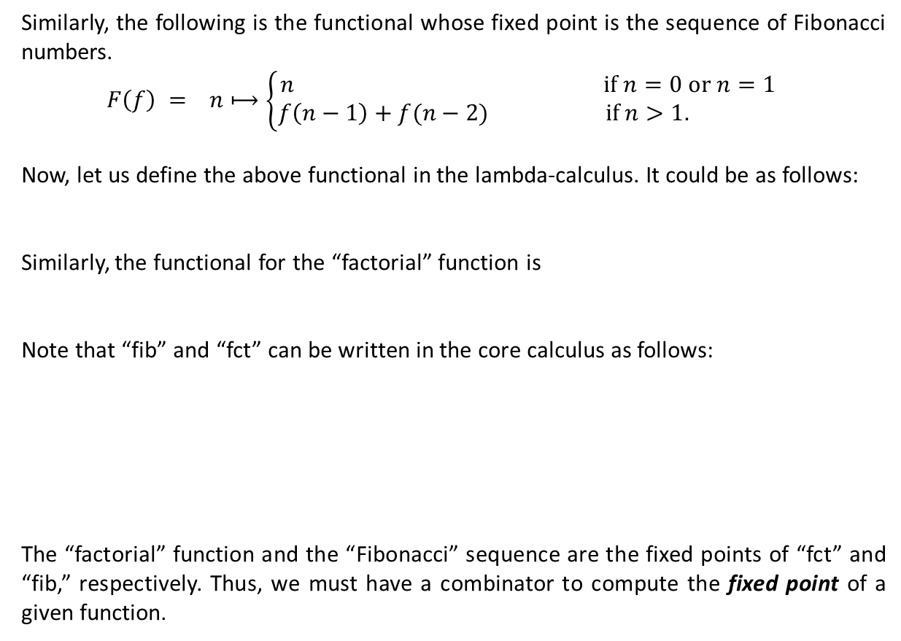


Recursive Function Definition (Ctd.)
Similarly, the following is the functional whose fixed point is the sequence of Fibonacci numbers.
$$F\left(f\right) = n⟼\left\{\begin{matrix}n & if n=0 or n=1 \\ f\left(n−1\right)+f(n−2) & if n>1.\end{matrix}\right.$$
Now, let us define the above functional in the lambda-calculus. It could be as follows:
Similarly, the functional for the “factorial” function is
Note that “fib” and “fct” can be written in the core calculus as follows:
The “factorial” function and the “Fibonacci” sequence are the fixed points of “fct” and “fib,” respectively. Thus, we must have a combinator to compute the fixed point of a given function.
$$g$$
fib = $λ$f. $λ$n. if n = 0 or n = 1 then n else (f (n - 1) + f (n - 2)).
fct = $λ$f. $λ$n. if n = 0 then 1 else (n * f (n - 1)).
fib = $λ$f. $λ$n. test (or (iszero n) (iszero (subtract n c₁))) n (plus (f (subtract n c₁)) (f (subtract n c₂))).
fct = $λ$f. $λ$n. test (iszero n) c₁ (times n (f (subtract n c₁))).

Slide 7






Fixed-Point Combinators
Recall that a term that cannot take a step under the evaluation relation is called a normal form.
Interestingly, some terms cannot be evaluated to a normal form. For example, the divergent combinator
contains just one redex, and reducing this redex yields exactly omega again. Terms with no normal form are said to diverge.
The omega combinator has a useful generalization called the call-by-name fixed-point combinator (or Y-combinator).
Like omega, the Y-combinator has an intricate, repetitive structure; it is difficult to understand just by reading its definition. Probably the best way of getting some intuition about its behavior is to watch how it when applied to a term.
omega = ($λ$x. x x) ($λ$x. x x)
Y = $λ$f. ($λ$x. f (x x)) ($λ$x. f (x x))
Y g
$=$ ($λ$f. ($λ$x. f (x x)) ($λ$x. f (x x))) g
$=$ ($λ$x. g (x x)) ($λ$x. g (x x))
$=$ g( ($λ$x. g (x x))($λ$x. g (x x)))
$=$ g (Y g)
The term Y g is a fixed point of g under the call-by-name evaluation strategy.

Slide 8










Fixed-Point Combinators (Ctd.)
The factorial function can now be encoded in the lambda-calculus as
where
Now, we compute “factorial 3,” for example.
factorial = Y fct.
fct = $λ$h. $λ$n. if n = 0 then 1 else (n * h (n - 1)) and
Y = $λ$f. ($λ$x. f (x x)) ($λ$x. f (x x)).
factorial 3
$=$ Y fct 3
$=$ ($λ$f. ($λ$x. f (x x)) ($λ$x. f (x x)) fct 3
$=$ ($λ$x. fct (x x)) ($λ$x. fct (x x)) 3
$=$ fct ( ($λ$x. fct (x x))($λ$x. fct (x x))) 3
$=$ ($λ$n. if n = 0 then 1 else (n * (($λ$x. fct (x x))($λ$x. fct (x x))) (n - 1))) 3
$=$ 3 * (($λ$x. fct (x x))($λ$x. fct (x x))) 2)
$=$ 3 * (fct ( ($λ$x. fct (x x))($λ$x. fct (x x))) 2)
$=$ 3 * (($λ$n. if n = 0 then 1 else (n * (($λ$x. fct (x x))($λ$x. fct (x x))) (n - 1))) 2)
$=$ 3 * 2 * (($λ$x. fct (x x))($λ$x. fct (x x))) 1)
$=$ 3 * 2 * (fct ( ($λ$x. fct (x x))($λ$x. fct (x x))) 1)
$=$ 3 * 2 * (($λ$n. if n = 0 then 1 else (n * (($λ$x. fct (x x))($λ$x. fct (x x))) (n - 1))) 1)
$=$ 3 * 2 * 1 * (($λ$x. fct (x x))($λ$x. fct (x x))) 0)
$=$ 3 * 2 * 1 * (fct ( ($λ$x. fct (x x))($λ$x. fct (x x))) 0)
$=$ 3 * 2 * 1 * ($λ$n. if n = 0 then 1 else n * (($λ$x. fct (x x))($λ$x. fct (x x))) (n - 1)) 0)
$=$ 3 * 2 * 1 * 1
$=$ 6

Slide 9



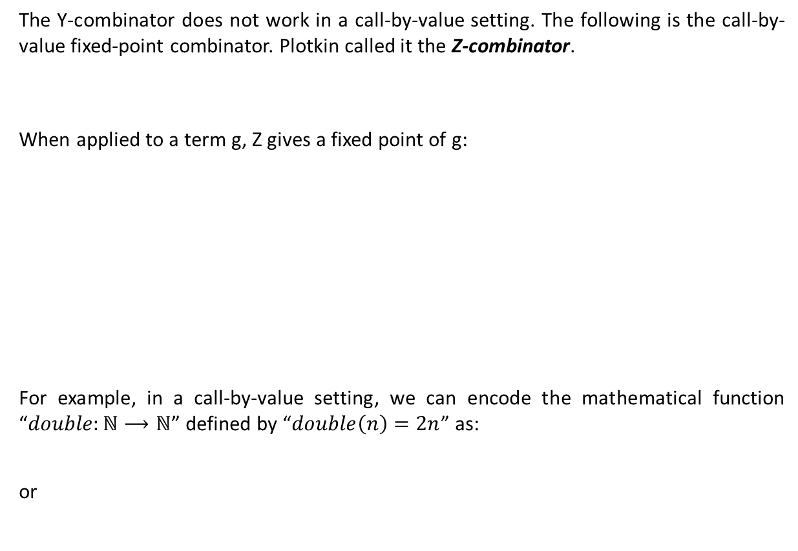





Fixed-Point Combinators (Ctd.)
The Y-combinator does not work in a call-by-value setting. The following is the call-by-value fixed-point combinator. Plotkin called it the Z-combinator.
When applied to a term g, Z gives a fixed point of g:
For example, in a call-by-value setting, we can encode the mathematical function “$double:ℕ⟶ℕ$” defined by “$double\left(n\right)=2n$” as:
or
Z = $λ$f. ($λ$x. f ($λ$y. x x y)) ($λ$x. f ($λ$y. x x y))
Z g
$=$ ($λ$f. ($λ$x. f ($λ$y. x x y)) ($λ$x. f ($λ$y. x x y))) g
$=$ ($λ$x. g ($λ$y. x x y)) ($λ$x. g ($λ$y. x x y))
$=$ g ($λ$y. ($λ$x. g ($λ$y. x x y)) ($λ$x. g ($λ$y. x x y)) y)
$η$-equality
$=$ g ($λ$x. g ($λ$y. x x y)) ($λ$x. g ($λ$y. x x y)))
If x is not free in t, then $λ$x. t x $=$ t
$=$ g (Z g)
double = Z ($λ$f. $λ$n. if n = 0 then 0 else (2 + f (n – 1))
double = Z ($λ$f. $λ$n. test (iszero n) c₀ (plus c₂ (f (subtract n c₁)))).

Slide 10
Types and Programming Languages by Benjamin Pierce (Chapter 5)
Please see Assignment 3 at http://courses.aut.ac.ir.

